Slide 1




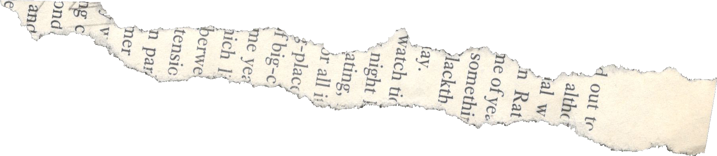
UNIVERSITY OF MILANO - BICOCCA
LM DATA SCIENCE
PRESENTATION
SPOTIFY ANALYSIS
ISMAIL AHOUARI (896440),
MEHDI MOUALIM (898516),
QASIM MUHAMMAD (897683)
PR.ANDREA MAURINO

Slide 2



Plan
Introduction
Data Acquisition
Data Integration and Cleaning
Quality Assessment
Exploratory Analysis

Slide 3


INTRODUCTION
In the Era of Music Streaming, Spotify reigns as a leading platform, offering an extensive library of songs spanning genres, artists, and cultures. Our Data Management project focused on a comprehensive analysis of Spotify's data, utilizing the Spotify API and scraping lyrics from popular websites. Our goal was to explore Spotify's structure, diversity of music, attention-grabbing techniques, and uncover patterns through data Management Technics.

Slide 4





DATA ACQUISITION
API
WEB SCRAPPING
SPOTIFY
Wikipedia
VAGALUME
LETRAS

Slide 5

Data InterGration & Cleaning
Matched Songs and Lyrics: Used unique identifiers to match songs from Spotify API with their corresponding lyrics
1
2
Combined data obtained from the Spotify API and scraped lyrics
Verified the coherence and integrity of the merged dataset through careful examination and comparison.
3
Removed duplicate entries, handled missing data points, and standardized formats
4
Standardized variables and formats to ensure consistency across the dataset
5

Slide 6




QAULITY ASSESSMENT
COMPLETENESS
our dataset is comprehensive, covering a wide range of attributes such as song features, artist details, popularity scores, and release dates.
With minimal missing values and a comprehensive collection of songs spanning multiple genres and time periods, our dataset provides a solid foundation for in-depth analysis and meaningful insights into the music industry

Slide 7
QAULITY ASSESSMENT
ACCURACY
Our dataset is sourced directly from Spotify, a trusted music streaming platform, ensuring reliable and accurate song metadata and popularity information. The lyrics were obtained through scraping two reputable websites, enhancing the accuracy of the lyrical data. While slight variations may exist across sources we are not sure 100%, overall, the data is reliable and provides valuable insights into the music industry.

Slide 8
QAULITY ASSESSMENT
CONSISTENCY
Our dataset demonstrates a high level of consistency, ensuring reliable analysis and accurate insights.
All columns and variables in the dataset follow a standardized format, making it easier to analyze and compare different attributes.
All data entries were carefully validated and cross-checked to identify any inconsistencies or discrepancies.

Slide 9
QAULITY ASSESSMENT
CURRENCY
Dataset Timeliness: Our dataset covers the years 2010 to 2022, providing a substantial timeframe that captures a wide range of song releases. Although it may not include the most recent releases, it reflects the evolving music landscape over the past decade.
Relevance to Music Industry Trends: By including data from the music industry, our analysis offers insights into prevailing trends and preferences. While the industry continues to develop, our dataset serves as a valuable resource for understanding the dynamics and patterns that have shaped the music industry.

Slide 10
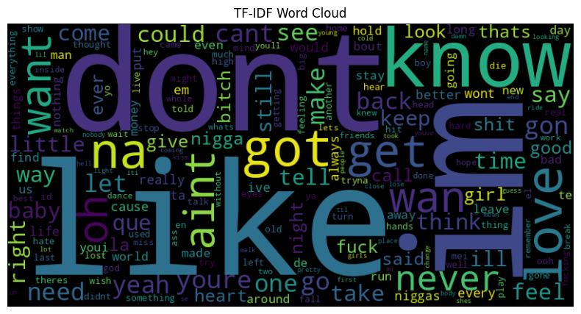
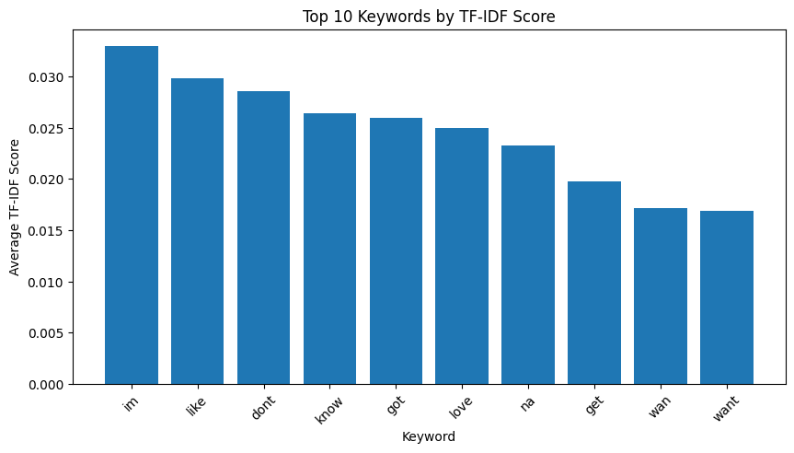
DATA EXPLORATION
TD-IDF
Term Frequency-Inverse Document Frequency
helps us gain insights into the prevailing themes, emotions, and expressions that have resonated with audiences

Slide 11
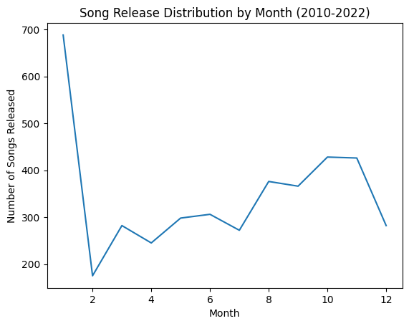
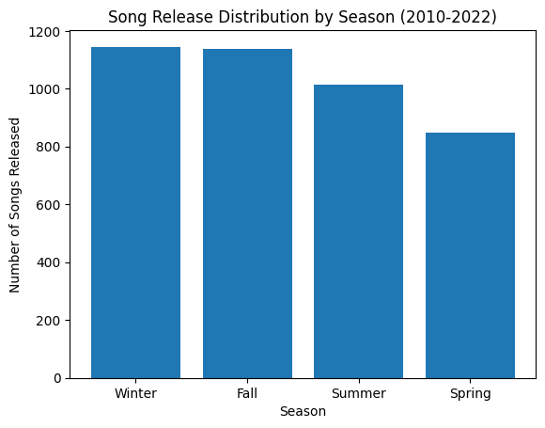
DATA EXPLORATION
Song Release
January Peak: Songs released in January benefit from increased music consumption after the holiday season.
Winter and Fall Focus: The popularity of songs released in winter and fall is driven by indoor activities and significant events during these seasons.

Slide 12
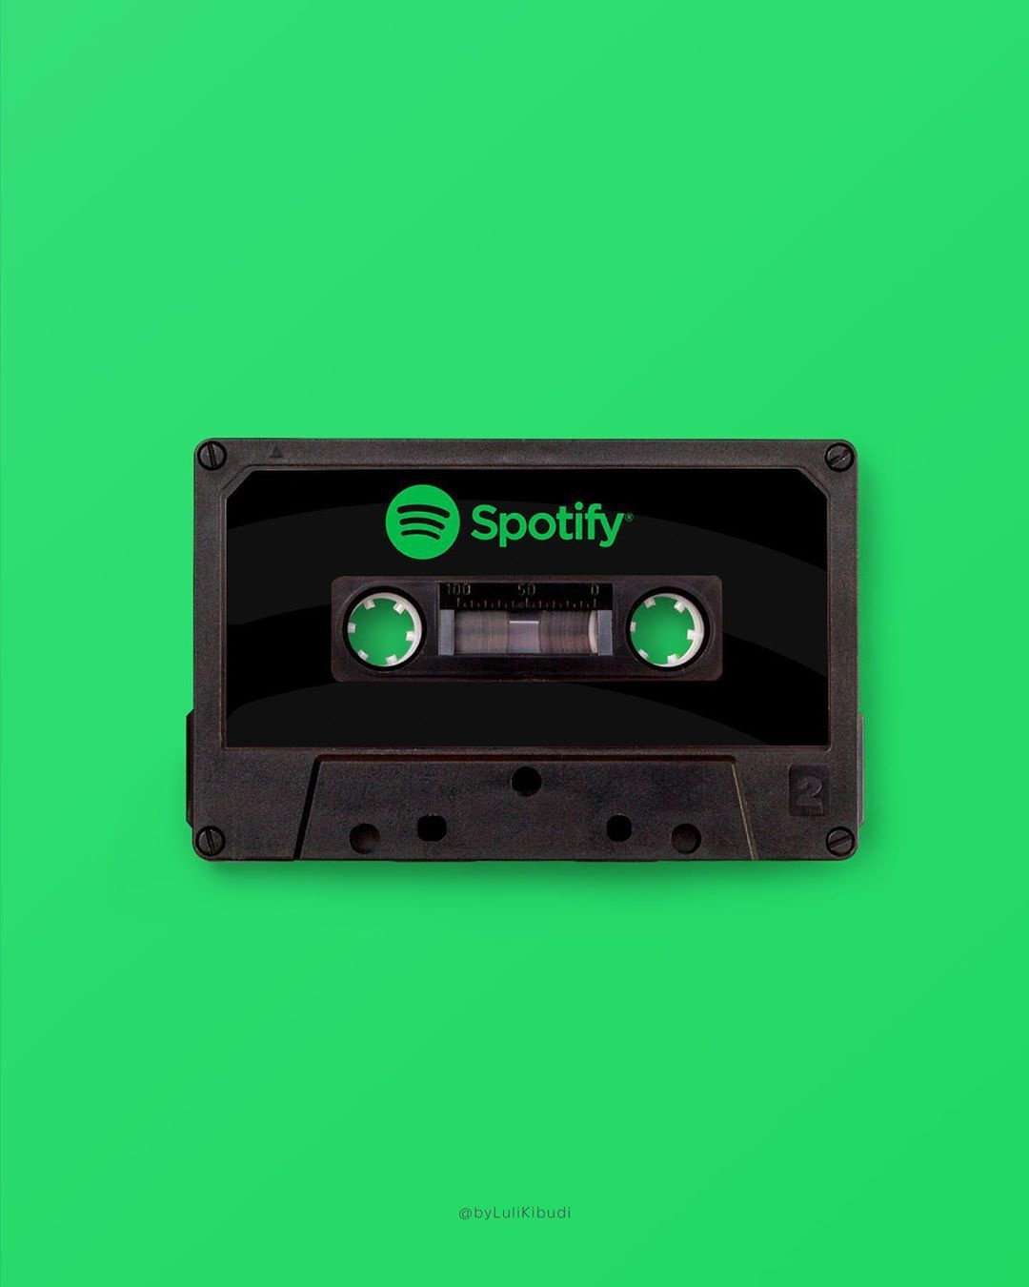
THANK YOU

